Slide 1

Promoting Safe Early Care and Education for All
California AB 495 / Family Preparedness Plan Act
June 23, 2026
Notes:
Depending on the presentation: Explain the translation/simultaneous interpretation; How to get to language channel. We will send out the slides after. We are recording.
Why we decided to do the presentation? What does this presentation cover?
We want to inform childcare providers about the AB 495 - the Family Preparedness Plan Act – what it is, who it applies to, your rights as providers, and how to create policies for your childcare business to ensure that you’re following the new law.
We also want to arm childcare business owners and staff with the knowledge of what their rights and responsibilities are if ICE appear.
Also want to honor the knowledge in the room, many of you have lived experience with ICE.
Please feel free to put questions in the chat as we go on and we will have time at the end for Q&A.

Slide 2

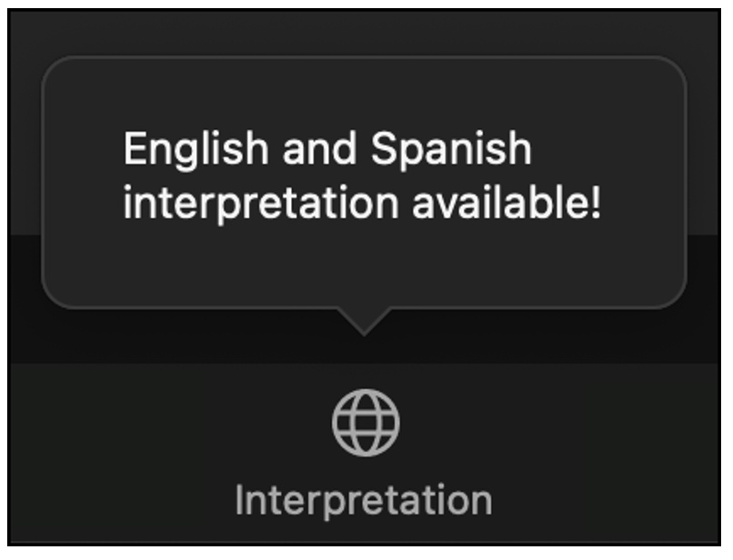
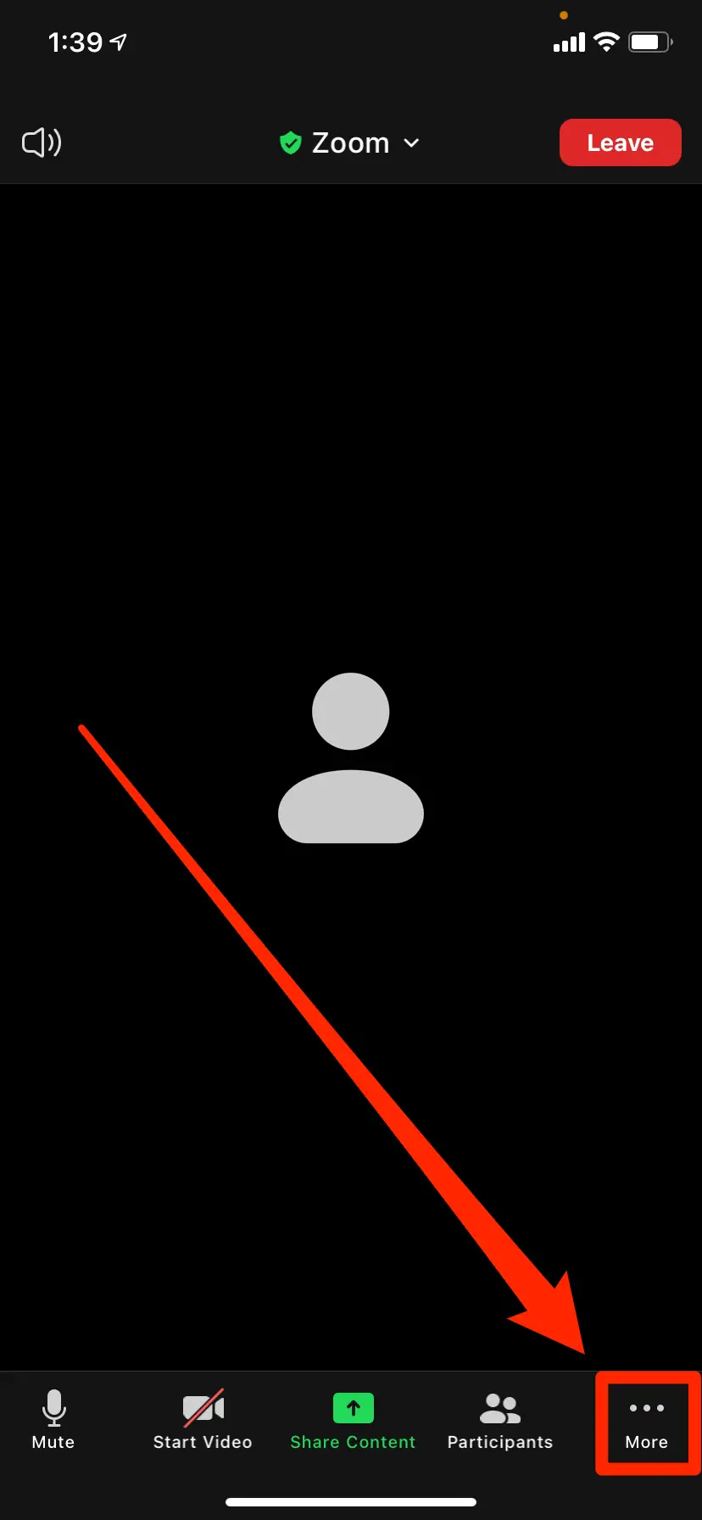
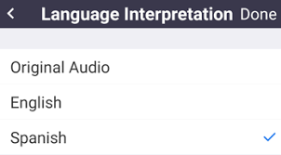
Welcome Bienvenidos
Select Your Language / Eliga su idioma
Oprima el botón marcado “Interpretation” (el globo)
en la parte baja de la pantalla. Seleccione “Spanish”.
Computer / Computadora
Phone / Por Telefono
Notes:
Before we dive into our topic today I want to share a few reminders:
Today’s webinar provides live Spanish translation. To access it, click on the Interpretation Icon in your Zoom controls. Then, select Spanish. To mute the English in the background, select Mute Original Audio.
El seminario web de hoy se interpretará en vivo al español para quienes lo deseen. Para acceder a este servicio, haga clic en el icono de interpretación en los controles de Zoom. Luego, seleccione español. Para silenciar el inglés de fondo, seleccione Silenciar el audio original (Mute Original Audio).
We want to thank our interpreters. Le agradecemos a nuestros intérpretes

Slide 3



Presentation by:
ALL IN for Safe Schools is a California-based campaign that brings together early childhood education and K-12 non-profit leaders to support educators in creating welcoming, inclusive, and affirming spaces—especially for children in immigrant families and LGBTQ+ students.
Learn more at allinforsafeschools.org
Notes:
This presentation is brought to you by ALL IN for Safe School - a CA-based campaign that brings together education advocates to support educators and providers in creating welcoming, safe spaces - with a focus on children in immigrant families and LGBTQ+ students.

Slide 4
Disclaimer
This presentation is intended as a general overview and is for information purposes only. This presentation should not be construed as all-inclusive, nor as the provision of legal services to any individual or entity. Attending this presentation does not create any attorney-client relationship.
Notes:
RM

Slide 5
Introductions
Public Counsel is a nonprofit public interest law firm that provides free legal assistance to small business owners and nonprofits, including child care providers.
Andrea Fernandez Mendoza is the Vice President of Education at the CA Children’s Academy, a nonprofit that provides free and affordable early education to low income working families.
Notes:
RM

Slide 6
Overview
Today we will cover:
  Background
  AB 495 Overview
  Who is covered by AB 495?
  What does AB 495 require from child care providers?
  Model Policies
  What to do if immigration agents are at the door
  Compliance Checklist
  Takeaways
  Resources
  Q&A
Overview
Notes:
CB

Slide 7

Grounding
As we move through today’s training, we want to remind you that your well-being matters.
Some of what we will cover – such as threats of raids, deportation, risks to your safety can bring up strong emotions, stress, or painful memories.
It is completely normal to feel overwhelmed, stressed, or afraid.
Please take care of yourself – step out, stretch, get water, or take a deep breath.
Our goal is to support you – not add stress. You’re not alone.
Grounding
Notes:
CB

Slide 8
Gentle Movements to Release Tension
Gentle Breathing
Inhale deeply through your nose…and slowly release the air through your mouth.
Let’s do it again, filling the lungs like a balloon…and slowly releasing the air.
Releasing the Shoulders
Now let’s move our shoulders a bit. Gently raise your shoulders toward your ears as you inhale…and as you exhale, let them drop, like releasing a sigh.
Let’s repeat it a couple more times, lifting as we inhale… and releasing as we exhale.
Relaxing the Jaw
Sometimes we clench our jaw without realizing it. If you feel comfortable, gently move your jaw from side to side.
You can also open your mouth slightly as if you were yawning and allow any tension to melt away.
Grounding
Notes:
CB

Slide 9
Background: Andrea Fernandez Mendoza from CA Children’s Academy
Notes:
AM
Andrea to share context behind new immigration policies and how its impacted her program and families as well as why learning about AB 495 is important.

Slide 10
What Is AB 495?
Notes:
CB

Slide 11
About AB 495
AB 495 is the Family Preparedness Plan Act of 2025, a California law designed to protect family privacy and children’s wellbeing when immigration enforcement threatens family stability.
Requires CA Attorney General to issue guidance and model policies for childcare providers
Requires certain childcare providers to adopt these policies by July 1, 2026
Focuses on keeping facilities and children safe and accessible regardless of immigration status
Encourages emergency preparedness for families
What is AB 495?
Notes:
CB
Last year, California passed a new law called the Family Preparedness Act of 2025 (AB 495) to protect family privacy and children’s well-being. It became effective January 1st of this year (2026).
The law is designed to ensure the safety and privacy of children and families as well as the accessibility of childcare homes and centers regardless of a family’s immigration status.
It was created to protect the continuity of care for children, reduce fear for families, help providers respond lawfully, preserve trust in childcare settings, and keep the focus on child safety rather than enforcement.
The law requires the California Attorney General to issue model policies for childcare providers. Only certain types of providers are required to adopt these policies. In the coming slides, we’ll tell you which providers this law explicitly applies to and when those providers are required to adopt the model policies.
However, it’s recommended that all providers adopt these or similar policies to partner in creating safe and protective environments for children and families and to comply with the law.
The law also encourages families to plan for emergencies – for example, who will care for a child in the event that a parent is detained

Slide 12
Before vs. After AB 495
Before AB 495, many child care providers relied on general privacy laws or school-based guidance that did not directly address child care settings.
After AB 495, providers have specific statewide rules and model policies to follow that limit the impacts of immigration enforcement on children and families.
What is AB 495?
Notes:
CB
AB 495 equips childcare providers with clear policies to safeguard family privacy and shield children from the impacts of immigration enforcement.
Before AB 495:
No comprehensive child-care-specific immigration response framework
Inconsistent practices across facilities
Less clarity for staff responding to ICE requests
Limited formal preparedness expectations
After AB 495:
Clear model policies
Stronger emergency contact planning
Generally prohibits collection unless legally required
Formal response guidance for enforcement requests

Slide 13
Who Is Covered By AB 495?
Notes:
CB

Slide 14
Does AB 495 apply to my child care program?
Yes, AB 495 applies to:
California state preschool programs (licensed and license-exempt)
Licensed child care centers and homes
No, AB 495 does not apply to:
Providers caring for children who are related to them
Providers caring for one family in addition to their own
Certain parent-run-co-op daycares
Certain temporary on-site daycares
Who is covered by AB 495?
Notes:
CB
While AB 495 specifically requires certain childcare businesses to adopt the Attorney General’s model policies, it is recommended that all childcare providers adopt these or similar policies to ensure that children and families are protected from the impacts of immigration enforcement.
Who must follow:
California State Preschool Programs – licensed and licensed-exempt – must adopt policies by July 1, 2026
“License-exempt California State Preschool Program facilities” refers to those California State Preschool Program classrooms operated by LEAs under contract with the California Department of Education (CDE) that meet additional operating requirements in a school building and that meet specified conditions.
Licensed childcare centers and most family childcare homes – adopt model policies or use equivalent protections by July 1, 2026 (highly encouraged)
“Licensed child daycare facilities” refers to all licensed child care facilities in California, including all licensed California State Preschool Programs (CSPPs). This includes most family child care homes, preschools, and other early childhood education facilities in California. ​
All ECE and child care providers must review their own policies to make sure they do not conflict with these model policies, and any information, policies, or guidance provided by facilities to parents or authorized representatives must be revised if they do.
It’s only recommended that the following adopt model policies:
Providers caring for children who are related to them
Providers caring for one family in addition to their own
Certain parent-run-co-op daycares
Certain temporary on-site daycares
Please reach out to an attorney if it is unclear whether AB 495 applies to your childcare business.

Slide 15
What Does AB 495 Require?
Notes:
CB

Slide 16
How can I comply with the law?
Only ask for necessary information
Do not share personal information about children and their families unless required or authorized by law
Require immigration agents to present a judicial warrant before entry
Ask parents/guardians to update emergency contact information regularly
Report law enforcement visits and information requests
Share CA Attorney General Model Policies with parents/guardians
What does AB 495 require?
Notes:
CB
Read general guidance from the slide.
We’ll discuss each of these requirements in more detail in the next slides.

Slide 17
Only ask for necessary information. Do not ask for…
Unless it is required by law or state-supported educational program rules, generally, providers should not ask for the following immigration-related information:
Immigration status
Citizenship status
Alien registration numbers
Social Security numbers
Unnecessary identity documents
What does AB 495 require?
Notes:
CB
The strongest protection is often not collecting unnecessary sensitive information in the first place. Unless the law or state-supported educational program rules require it, do not collect information about immigration status, citizenship status, alien registration numbers, social security numbers, or unnecessary identity documents.

Slide 18
Instead, ask for…
When multiple forms of documentation are allowed, accept options that reveal less personal information.
Alternative proof of relationship to child
Flexible work verification methods
Guardianship/caregiver forms when lawful
Documents that do not reveal birthplace/status
Keep all information collected confidential and secure. Discard sensitive information when it’s no longer needed.
What does AB 495 require?
Notes:
CB
When possible, collect documents that reveal less personal information.
Alternative proof of relationship to child – court orders or guardianship documentation, Caregiver Authorization Affidavits
Flexible work verification records – paystubs, tax returns, business ledgers
Any information collected must be kept confidential and secure.
Providers should limit staff access to records, keep files secure and private, use one administrator for requests, never casually discuss family information, and document unusual requests.
Discard any sensitive information once it’s no longer needed.

Slide 19
Only share what is required or authorized by law
Do not share personal information about children and their families unless required or authorized by law.
Your childcare business is required or authorized to share information if. . .
You receive a valid judicial warrant, judicial subpoena, or court order
The disclosure is directly connected with administering the program
You have handwritten permission from a parent or guardian
What does AB 495 require?
Notes:
CB

Slide 20
Require immigration agents to present judicial warrants before entry
Do not allow immigration enforcement agents to enter any private areas of your facility without a valid judicial warrant or court order.
Private areas may include:
Classrooms
Staff offices
Records rooms
Staff-only workspaces
Areas with children under supervision
Public areas may include: waiting areas, lobbies, parking lots open to the public
What does AB 495 require?
Notes:
CB
Not every part of a facility is open to the public. It’s important to know the difference between public and private spaces because you have the constitutional right to deny entry to private spaces without a valid judicial warrant or court order.
Private areas are spaces where individuals have a reasonable expectation of privacy and may include classrooms, staff offices, records rooms, staff-only workspaces, areas with children under supervision, etc. If an immigration agent comes to your childcare business and asks to enter, you can require that the agent show you a judicial warrant or court order before letting them into these private spaces.
Review the warrant or court order yourself. It must state your business’s address, what areas the agent is allowed to enter, at what times, and be signed by a judge.
Public areas may include lobbies, parking lots open to the public, etc. These are areas where the public can enter without permission. Agents may enter public areas without a judicial warrant or court order during normal business hours.

Slide 21

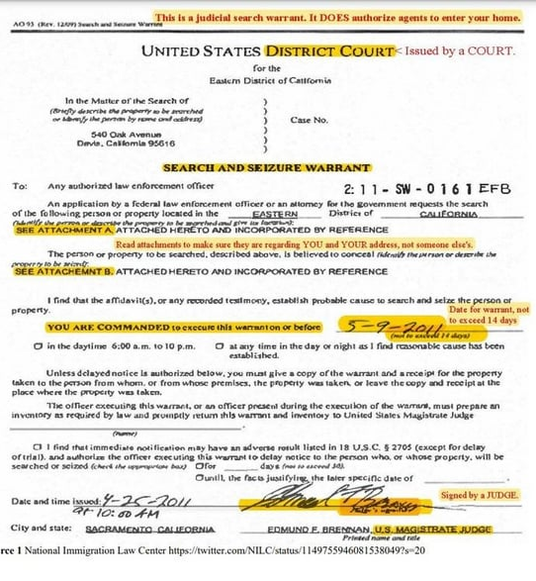
Judicial Warrants
Issued by judicial court and signed by a judge
Authorizes an arrest, seizure, or search. (verify the scope)
Law enforcement must execute it within 14 days
If valid, you must comply
Warrants & Subpoenas
Notes:
CB
Firstly we wanted to show you want a judicial warrant looks like because these you DO have to comply with. There are serious consequences for failing to comply.
It will be signed by a federal court judge or magistrate, not an immigration judge/agent.
Every time you’re going to scan it top to bottom:
Who issued it?
If it has an address on it, is it the correct address? Correct name? If it is an incorrect address you can let them know it is not valid. Incorrectly spelled names could be someone else.
Does it authorize a search of the facility or an arrest? What does it authorize?
It might say “Apartment 4, all common hallways, lobby of building.”
So limit it to that.
(4) Has it expired? Have more than 14 days elapsed since it was signed.
(5) Is it signed by a judge and not an immigration official?
What if they DO have a valid warrant? If the judicial warrant authorizes the arrest of a particular individual, you can ask that individual to come to the front of the school to meet the officer rather than giving the officer access to enter the school. Providing the officer access to enter the school can be construed as consent to a search and seizure regardless of whether they have a judicial warrant and what/who is listed in the warrant. An officer for example may then question people they encounter along the way, which could possibly lead to collateral arrests.
If the warrant is not a valid judicial warrant, you can deny the request. If the judicial warrant authorizes a search only of a particular office in your school, law enforcement may not use it as a basis for searching other offices, classrooms, storage rooms, etc. You can object if the law enforcement officer goes beyond the scope of the warrant or subpoena’s authority, beyond what the document states they can do.

Slide 22
Ask parents/guardians to update emergency contact information regularly
Routinely ask parents or authorized representatives to review and update emergency contact information as needed to ensure that a trusted adult can care for a child if a parent or guardian is detained or deported.
Encourage parents to plan for immigration enforcement-related emergencies.
  Please see Public Counsel’s family preparedness guide for more information
What does AB 495 require?
Notes:
CB

Slide 23
Report law enforcement visits and information requests
Licensed childcare facilities must report requests for information or access to the facility by an officer or employee of a law enforcement agency to the Attorney General and to the California Department of Social Services (CDSS).
To report to CDSS, file LIC 624 (for child care centers) or LIC 624B (for family child care homes).
What does AB 495 require?
Notes:
CB

Slide 24
Share Model Policies with parents/guardians
Finally, California state preschool providers are required to notify parents/guardians about the California Attorney General’s Model Policies and show parents/guardians how to access the policies their child care program has adopted.
While non-state preschool providers are not required to adopt the California Attorney General’s Model Policies, we recommend all providers prepare and use similar policies to protect staff and clients, and address interactions with immigration enforcement agents.
What does AB 495 require?
Notes:
RM

Slide 25
Model Policies
Notes:
RM

Slide 26
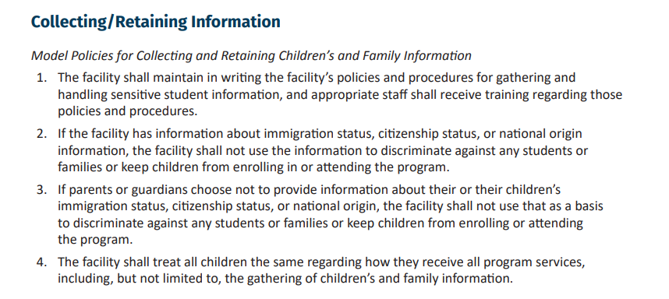
Model Policies
Model Policies
Notes:
RM
Share link in chat to model policies: B 495 “Promoting Safe Early Childhood Education for All” Guidance and Model Policies, (Appendix A, pages 45-52).
Pages 45-49 includes the model policies (what the previous slides have shown).
Pages 49-52 offer model best practices that are optional to adopt

Slide 27
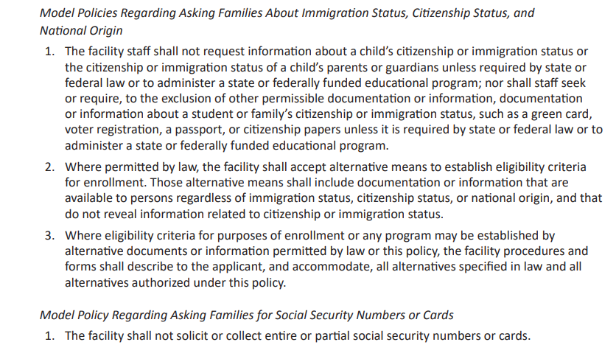
Model Policies
Model Policies
Notes:
RM
Share link in chat to model policies: B 495 “Promoting Safe Early Childhood Education for All” Guidance and Model Policies, (Appendix A, pages 45-52).

Slide 28
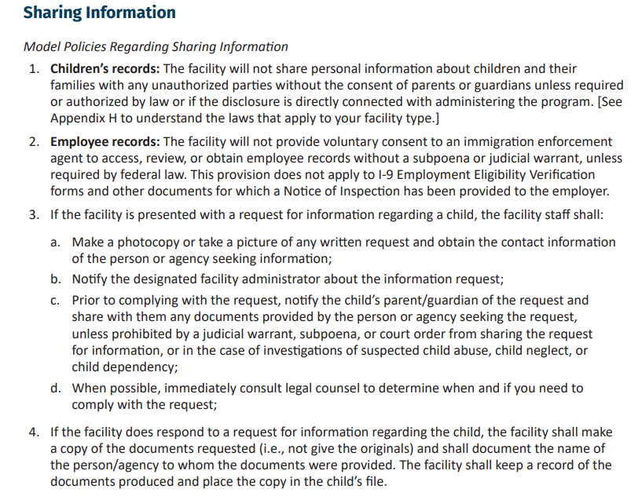
Model Policies
Model Policies
Notes:
RM
Share link in chat to model policies: B 495 “Promoting Safe Early Childhood Education for All” Guidance and Model Policies, (Appendix A, pages 45-52).

Slide 29
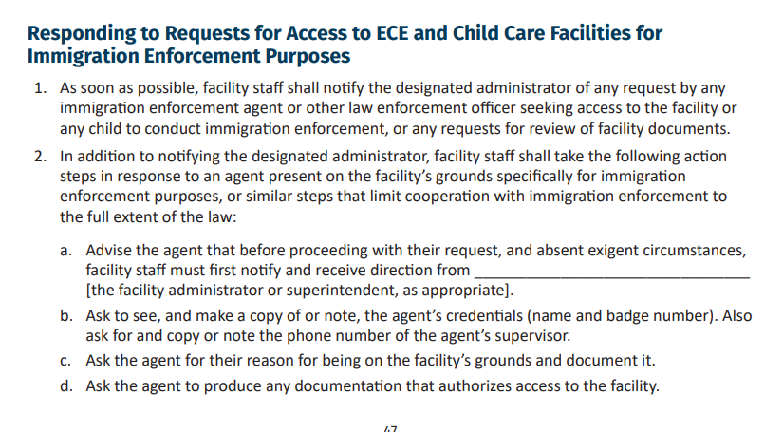
Model Policies
Model Policies
Notes:
RM
Share link in chat to model policies: B 495 “Promoting Safe Early Childhood Education for All” Guidance and Model Policies, (Appendix A, pages 45-52).

Slide 30
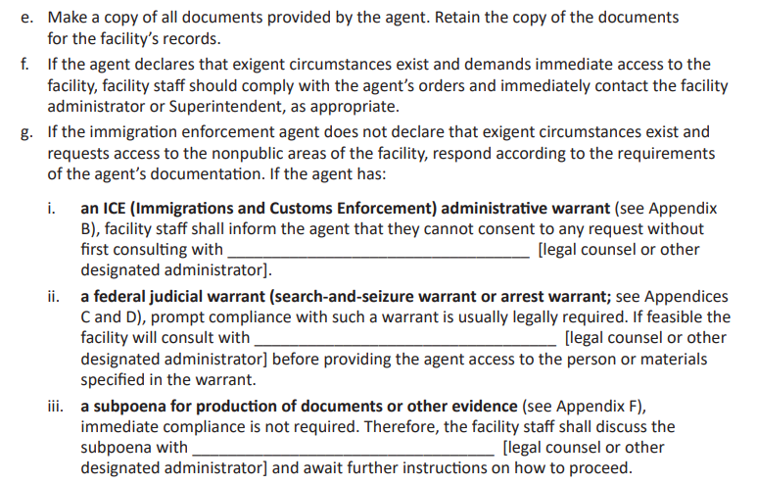
Model Policies
Model Policies
Notes:
RM
Share link in chat to model policies: B 495 “Promoting Safe Early Childhood Education for All” Guidance and Model Policies, (Appendix A, pages 45-52).

Slide 31
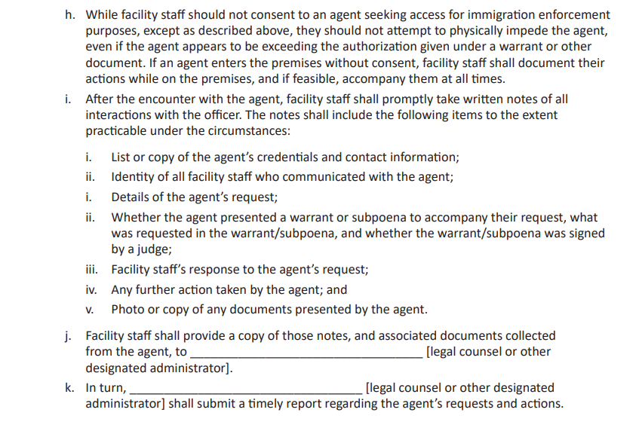
Model Policies
Model Policies
Notes:
RM
Share link in chat to model policies: B 495 “Promoting Safe Early Childhood Education for All” Guidance and Model Policies, (Appendix A, pages 45-52).

Slide 32
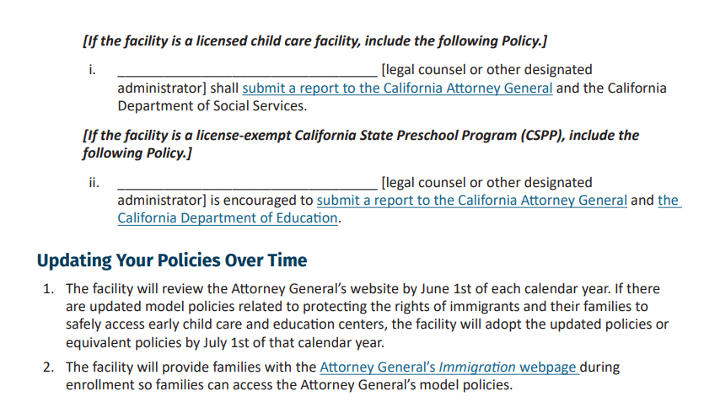
Model Policies
Model Policies
Notes:
RM
Share link in chat to model policies: B 495 “Promoting Safe Early Childhood Education for All” Guidance and Model Policies, (Appendix A, pages 45-52).
Pages 45-49 includes the model policies (what the previous slides have shown).
Pages 49-52 offer model best practices that are optional to adopt.
Andrea to share about how she’s adopted model policies

Slide 33
Recommended Practices & What To Do If Immigration Agents Are At The Door
Notes:
KM

Slide 34
Recommended Practices for Your Child Care Program
Help parents/guardians with their family preparedness plans in case of immigration-related emergencies
Update emergency contacts regularly, identify backup caregivers, keep forms current, follow written family instructions
Ensure staff understand their rights when interacting with immigration enforcement
How to verify judicial warrants and when to contact legal counsel. See Public Counsel’s interactions with immigration enforcement guide for further information.
Prioritize and safeguard the child’s emotional wellbeing if a parent is detained or cannot arrive
  Stay calm with the child, use approved emergency contacts, verify identity before release, notify leadership, and document actions taken
Recommended Practices
Notes:
KM
In addition to what’s on the slide…
Immigration concerns cannot become a reason to deny or discourage enrollment or services. Treat all children and families equally. Do not make enrollment decisions based on a family’s accent or the language they speak. Apply documentation rules fairly. Ensure families experience a welcoming enrollment process.
Don’t wait until an immigration enforcement event happens to prepare. The strongest protection for children and families is having clear systems already in place. This also helps staff respond calmly, consistently, and lawfully while keeping the focus on child safety.
To prepare now, review enrollment forms, remove unnecessary questions, update privacy policies, train all staff, practice response scripts.

Slide 35

So, immigration agents are at the door…
Stay calm. Don’t run. Contact the Authorized Person.
“You do not have permission to enter private areas without a judicial warrant. Please remain outside in this designated area.”
Authorized person inspects the provided documentation.
No judicial warrant: “We have a policy of denying access without a valid judicial warrant.”
Yes, valid judicial warrant: double check it, limit the search to the scope of the warrant, accompany them and document the whole time.
What to do when immigration agents are at the door
Notes:
KM
So what do you do when ICE is at the door? First, stay calm and don’t run. If you run, this can be taken as evidence of wrongdoing and cause for arrest.
Contact the authorized person.
If seen outside, have the authorized person go out by themselves to speak with them and confirm their identities. Try to avoid creating fear or confusion.
Read bullet #2.
Next the authorized person will look at what documentation they brought with them. – is it a search warrant? An arrest warrant? Do they have any documentation? Read with specificity!
We’ll discuss the warrants in detail on the next slide.
Read bullets 4 and 5.
Do not release any information about clients, staff, or others unless the warrant/subpoena specifically requires you to do so.
Do not help ICE agents sort people by immigration status or country they are from.
If they come with an administrative warrant with an employee’s name on it. You don’t have to say if the employee is working that day or not. And you do not have to take the ICE agent to that employee.
Let them do their job, but with supervision.
[read from slide]
If they try to take something that is vital to your business, you can explain why it is vital, and ask for permission to photocopy it before the original is seized.
Don’t allow yourself to be interrogated before consulting with an attorney.
If agents insist on seizing documents, document what they take. If they try to inspect attorney-client privileged docs, you can tell them its privileged and request those docs are not inspected until you speak with your attorney. Ask for a copy of the list of items seized during the search.
Object to any search outside the scope but don’t engage in a debate or argument. Simply present the objection and make a note of it. Whether it is a violation of your rights is a determination that the court will make later. Your attorney should handle that later.
Ask for a warrant
Do not give them permission to speak to your employees
Tell your employees their rights

Slide 36
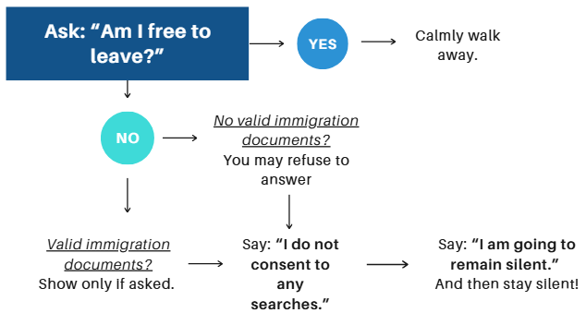
What if immigration agents stop and question me?
What to do when immigration agents are at the door
Notes:
KM
“Hello, it’s ICE police, we want to ask you a couple of questions.”
Let’s practice:
Am I free to leave?
I am going to remain silent.
I am not going to answer any questions.
I do not consent to a search.
You do not have to answer questions about your immigration status, where you were born, where you live, where you are from, or whether you have documents.

Slide 37
Compliance Checklist
Notes:
KM

Slide 38
Compliance Checklist
I have read the California Attorney General’s guidance.
I have adopted AB 495 Model Policies
  California State Preschool Programs must adopt by July 1, 2026
My child care’s policies with respect to immigration enforcement comply with AB 495 requirements
I have shared my policies with the families who have enrolled children at my child care
Compliance Checklist
Notes:
KM
By July 1, 2026, California State Preschool Programs must adopt the model policies.
Licensed childcare businesses are highly encouraged to adopt the model policies or very similar policies by that date as well.
Andrea to share about how she’s adopted model policies

Slide 39
Takeaways
Notes:
KM

Slide 40
Main Takeaways
Review and edit existing policies to comply with model policies and tell families where to find them
  For California State Preschool Programs, adopt policies by July 1, 2026
Limit collection of sensitive data
Protect confidentiality
Train staff in advance
Prepare family emergency systems
Keep children safe and supported
Takeaways
Notes:
KM

Slide 41
Resources
Notes:
KM

Slide 42
Helpful Resources
Public Counsel offers free legal support to childcare providers and can assist with drafting and reviewing program policies to ensure they comply with AB 495 requirements.
Complete an online intake form at https://publiccounsel.org/issues/community-development/early-care-education/#get-help or call (213) 385-2977 x 300 for assistance.
AB 495 “Promoting Safe Early Childhood Education for All” Guidance and Model Policies, (Appendix A, pages 45-52).
Find resources for providers and families or request a training at www.allinforsafeschools.org
Resources
Notes:
KM
Online application link – put in chat
https://publiccounsel.org/services/small-businesses/

Slide 43
Additional Resources
Work Authorization for Employers Guide https://publiccounsel.org/publications/work-authorization-faq-for-employers/
USCIS I-9 Guide https://www.uscis.gov/book/export/html/59502
Public Counsel’s ICE guidance for nonprofits and small businesses: https://publiccounsel.org/publications/faqs-on-nonprofit-and-small-business-rights-with-respect-to-immigration-enforcement-ice/
Family Preparedness Plans - https://www.ilrc.org/resources/step-step-family-preparedness-plan and https://publiccounsel.org/publications/a-guide-to-planning-for-your-childs-care-family-preparedness/
SB 81 California Attorney General Notice https://oag.ca.gov/system/files/attachments/press-docs/SB%2081%20Bulletin%20-%20October%202025.pdf
Resources
Notes:
KM
Red Cards - https://www.ilrc.org/red-cards - KYR - Nonprofits can order them for free. Helpful for staff and customers. You can also print your own.
Consulates – notifying family members

Slide 44

Rapid Response Hotlines
Immigrant Defenders Law Center Rapid Response Legal Resource Hotline (Los Angeles, San Bernardino, Orange, Riverside, San Diego, and Imperial counties)
  Purpose: Connecting to Detention Legal Services
  Hotline: (213) 833-8283
  Hours of Operation: Monday through Friday from 9AM-4PM PST
List of California Rapid Response Networks:
  https://www.ccijustice.org/carrn
Resources
Notes:
KM

Slide 45

Webinar Evaluation & Raffle
Please fill out this quick
Evaluation
We appreciate your feedback!
Responses collected within 24h of this webinar will be entered to win the prize
Three winners will be randomly selected and contacted via email & phone

Slide 46
Questions?
Notes:
KM

